Slide 1
UltraLite Coding: Banqi
Nicholas Walter
Tyler Hogenson
Spencer Lofing
Ben Finnerty
Max Maier

Slide 2
RECAP
Description of Banqi
Half/Blind Chinese Chess – game consists of tokens with various power levels, each placed face-down on the board in a random position. Tokens must be flipped face up (revealing color/power level) before you can move them – higher power level tokens can take higher power level tokens.
How much progress had we made at the end of the last increment?
Full implementation of the game (including the UI for the game); but only little progress for the database/server side of things
Where are we at now?
(Almost) fully functional, satisfying all of the core requirements excluding

Slide 3
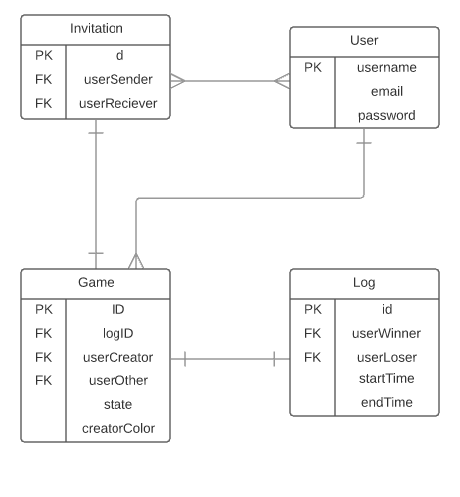
Entity Relationship diagram

Slide 4
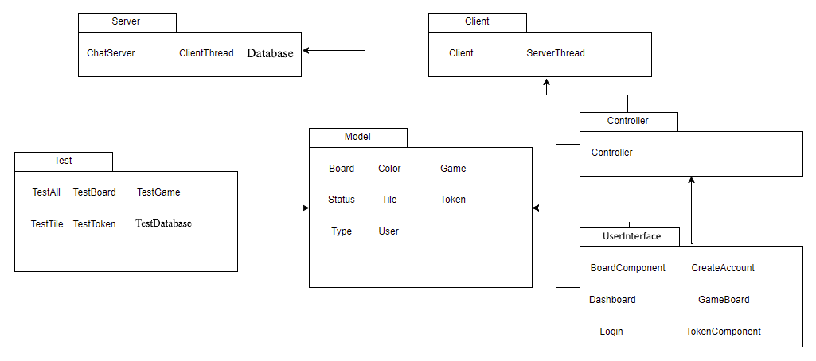
Package Diagram

Slide 5
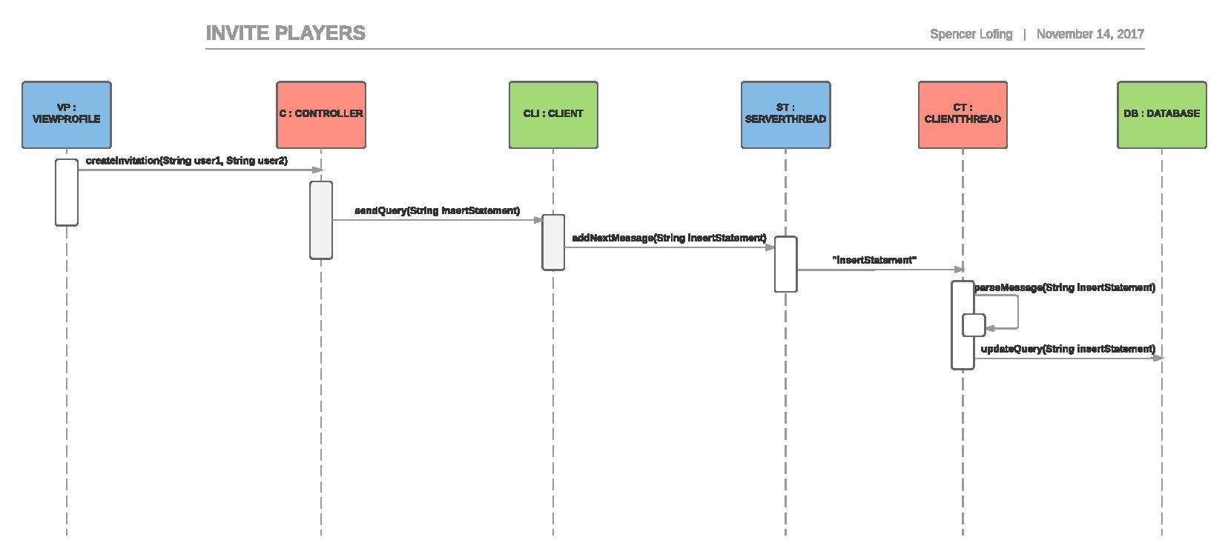
Updated sequence diagrams

Slide 6
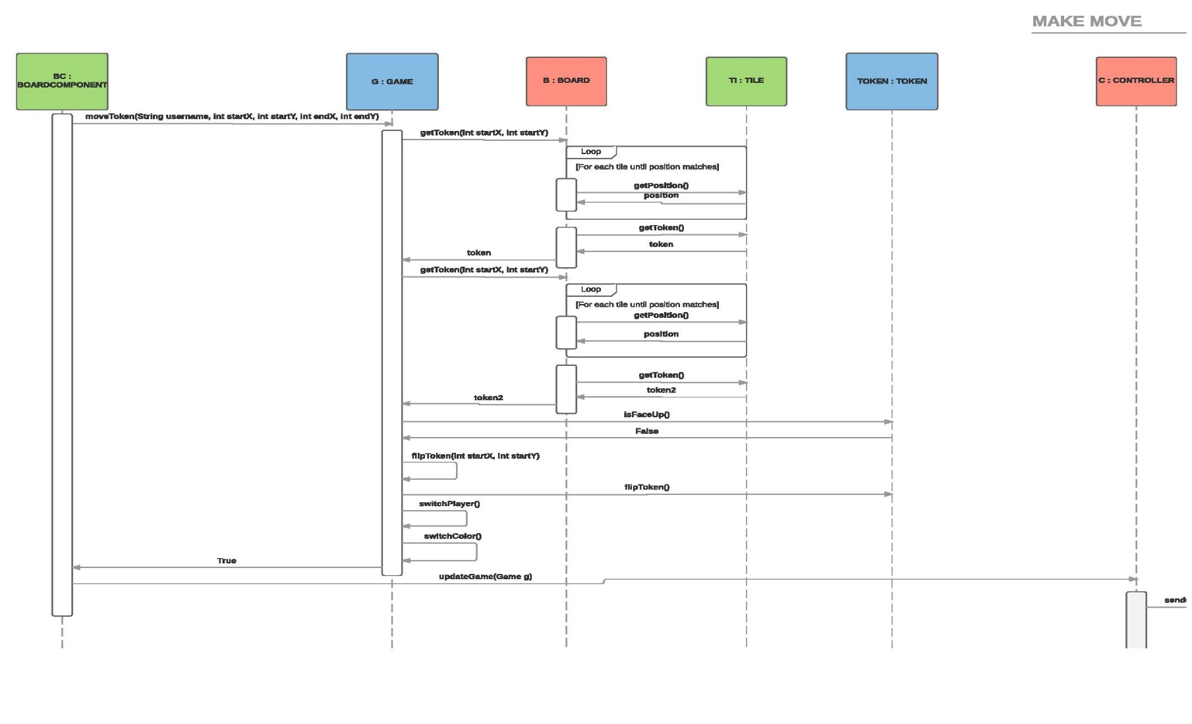
Updated sequence diagrams

Slide 7
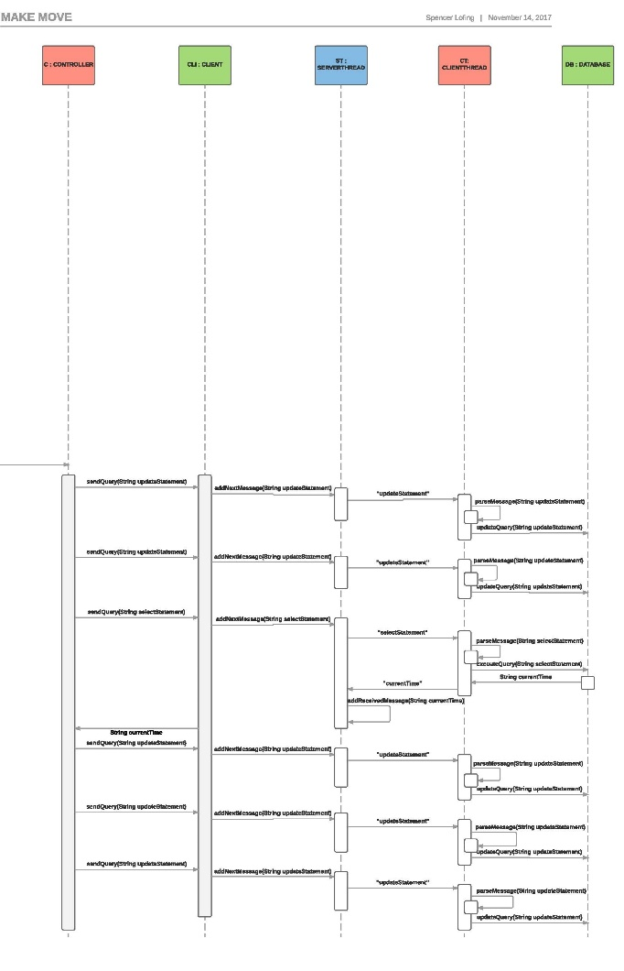
Updated sequence diagrams

Slide 8
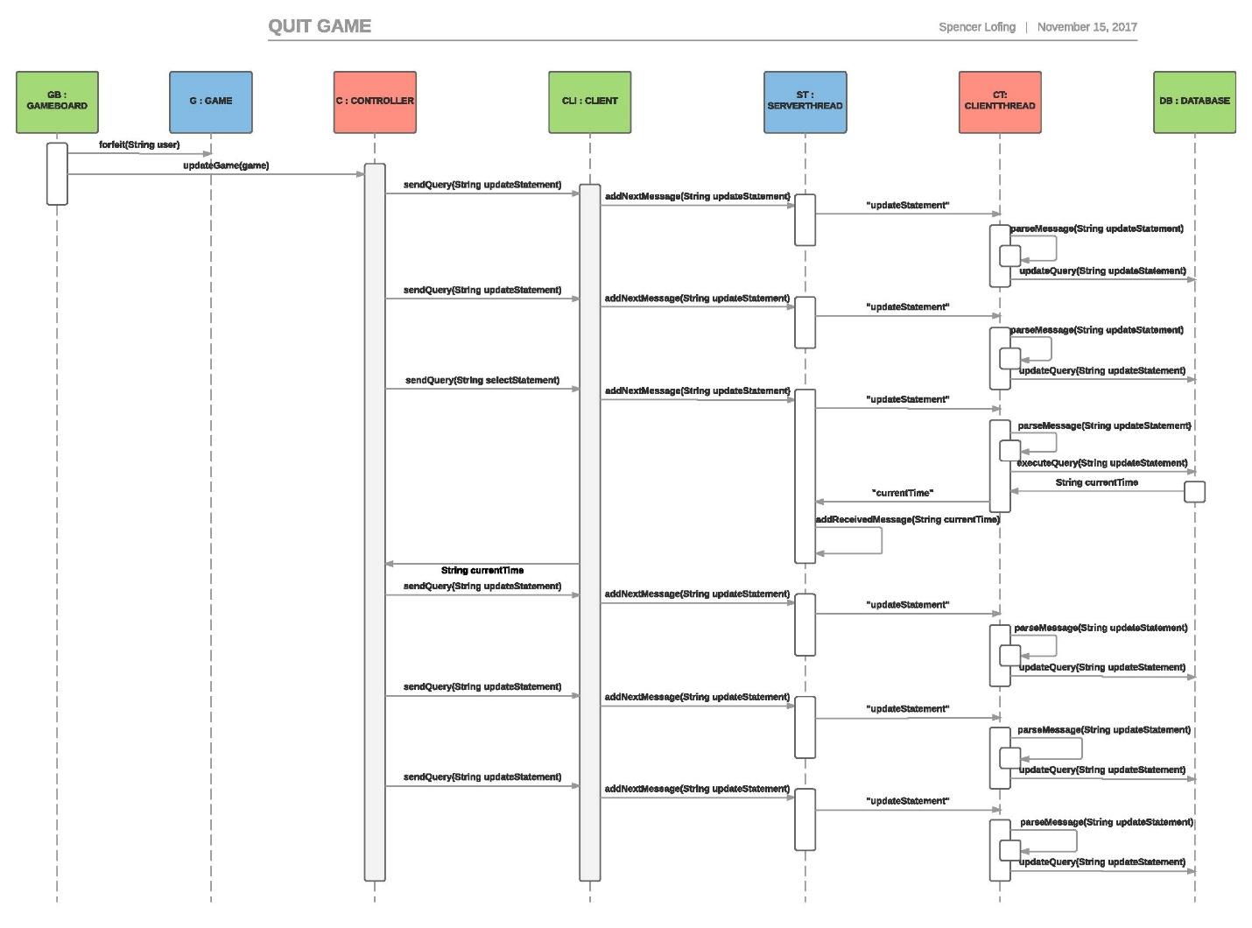
Updated sequence diagrams

Slide 9
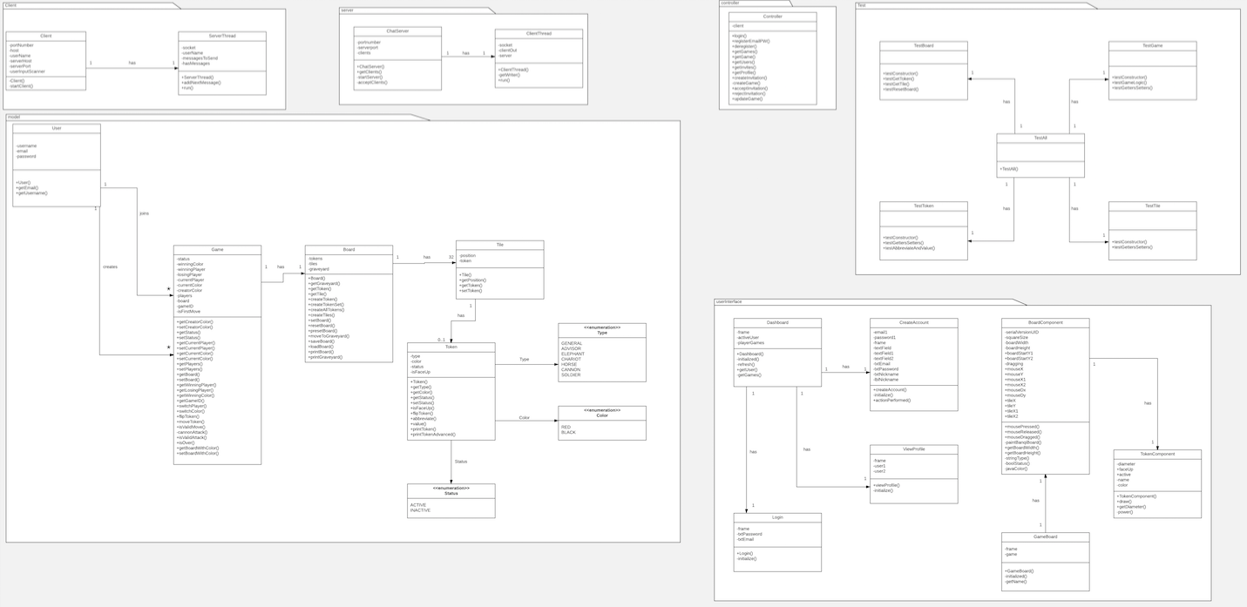
Updated Design Class Diagram, Overview

Slide 10
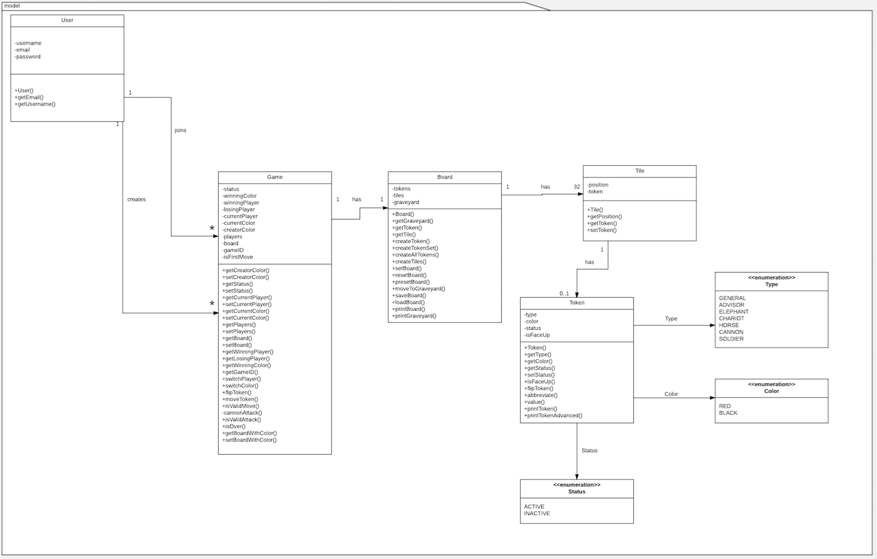

Slide 11
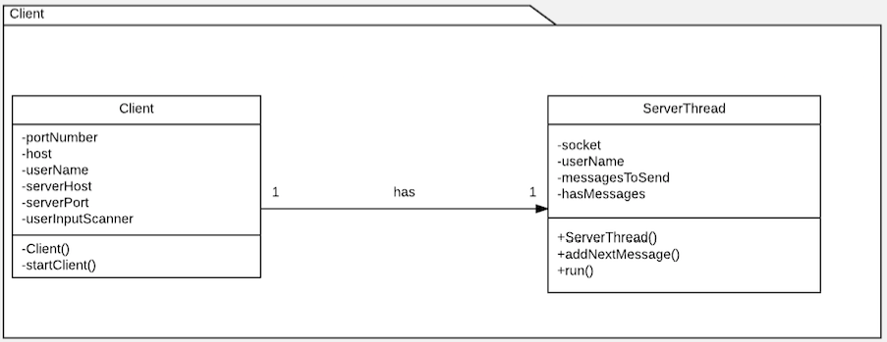
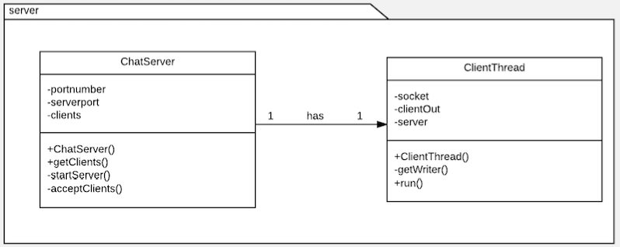

Slide 12
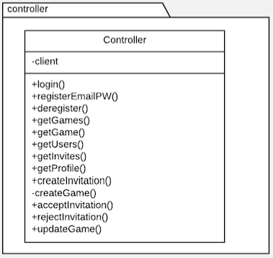
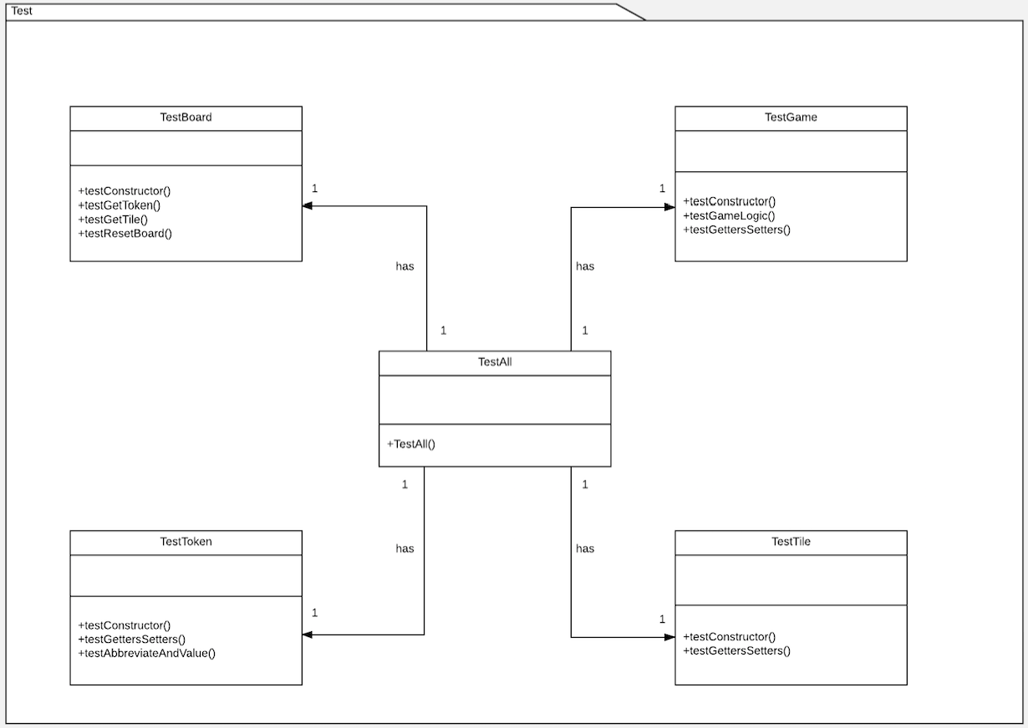

Slide 13
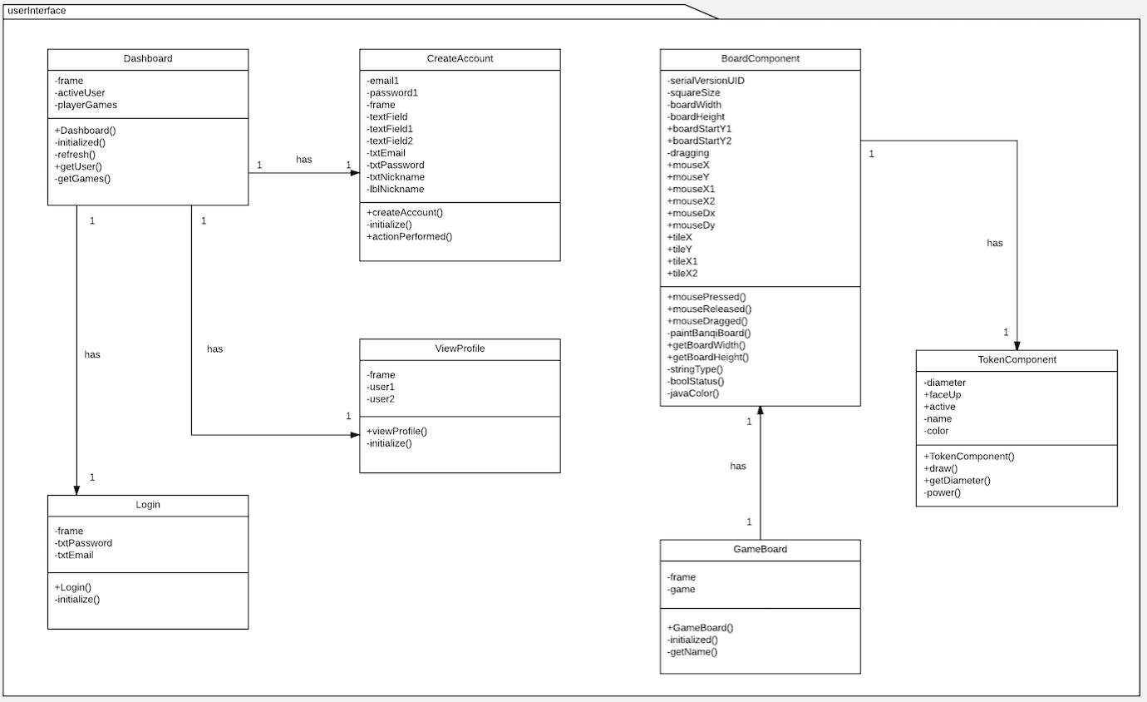

Slide 14
Refactoring and Design pattern list
Separated classes into Model-View-Controller packages
Implemented Façade Pattern by creating a few other packages
Used Extraction to reduce reuse of code within classes
Rearranged classes to have Low Coupling
Removed Log.java, Profile.java, and Invitation.java

Slide 15
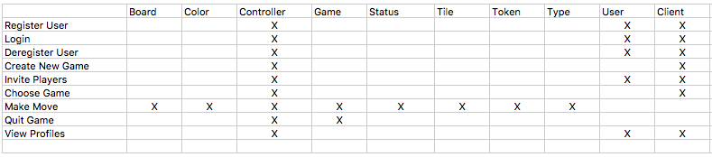
Traceability Link Matrix

Slide 16
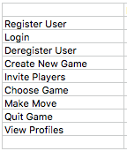
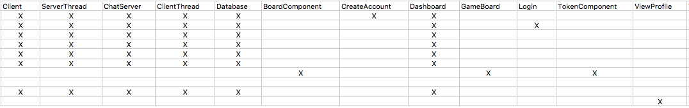

Slide 17
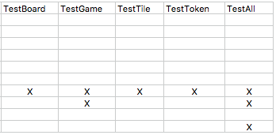

Slide 18
DEMO

